Slide 1
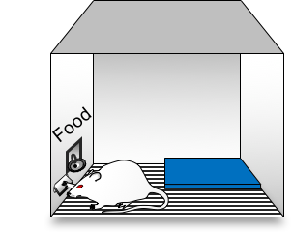
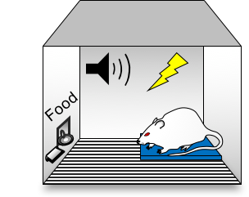
a
Avoidance conditioning
(8 or 20 days)
Pre-tone
Tone
b
8 days of conditioning
d
Last day of conditioning
% Time on platform
%Time freezing
Presses per min
% Time on platform
Presses/min
% Freezing
Avoidance
Pressing
Freezing
8d
20d
8d
20d
8d
1
2
3
4
5
6
7
8
20d
c
Days (blocks of 3 trials)
20 days of conditioning
% Time on platform
% Time freezing
Presses per min
1
Avoidance
Pressing
Freezing
2
3
4
5
6
7
8
9
10
11
12
13
14
15
16
17
18
19
20
Days (blocks of 3 trials)

Slide 2
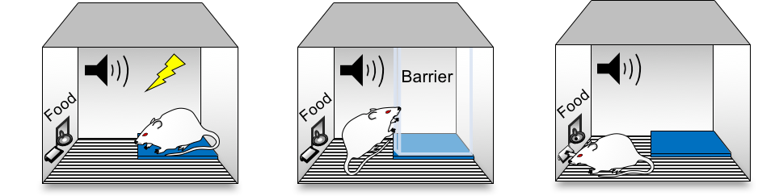
a
Ext-RP
(4 days, with barrier)
b
Test 1
(barrier removed)
c
EPM
24h
1h
**
**
*
**
**
*
% Suppression
**
**
**
**
*
**
20d group
**
**
1
2
3
4
**
**
**
**
**
Days (blocks of 3 trials)
% Time freezing
**
**
**
**
**
**
Open arm time (s)
**
**
**
**
*
*
8d group
**
8d
20d
1
2
3
4
Tone
Tone
Pre-tone
Pre-tone
8d group
8d
Pre-tone presses per min
*
*
**
**
20d
**
**
**
Presses per min
**
**
**
**
**
**
**
**
20d group
**
**
**
**
1
2
3
4
Tone
Days (blocks of 3 trials)
Pre-tone
d
Test 1
e
**
NP
(n=24)
P
(n=14)
NP
(n=10)
P
(n=30)
8d
20d
# of rats
% Time on platform
8d
20d
37%
Persistent
avoidance
75%
Persistent
avoidance
**

Slide 3
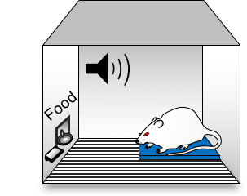
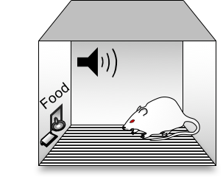

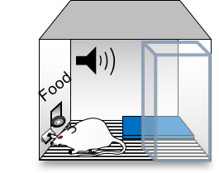
b1
Test 2a
(no barrier)
a
**
c
Test 1
(no barrier)
% Time on platform
% Time freezing
Test 3
(no platform)
##
8d
20d
8d
20d
Persistent rats
1h
b2
24h
Test 2b
(barrier away
from platform)
**
% Time on platform
% Time freezing
% Time freezing
##
8d
% Time in corner
20d
8d
20d
8d
Barrier
20d
8d
20d
As a note for us this is Significantly different with FISHER LSD (UNCORRECTED)
% Time freezing
% Time on platform
++
##
##
8d
20d
8d
20d

Slide 4

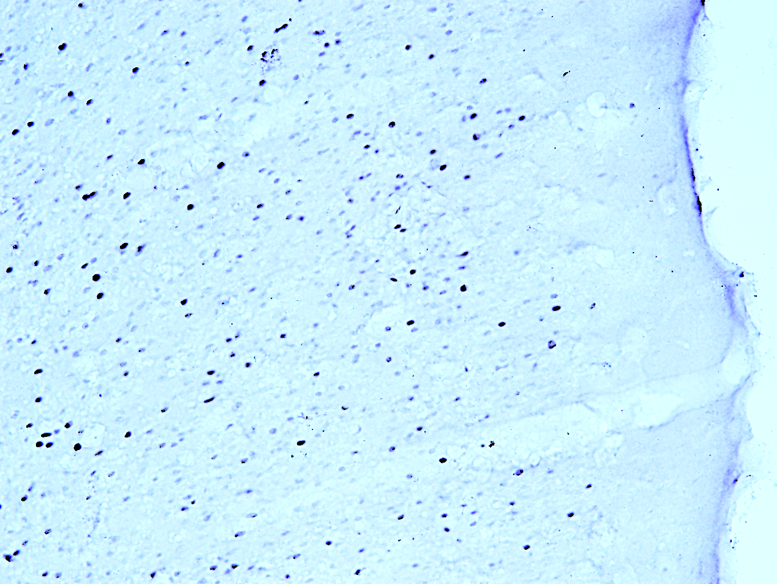
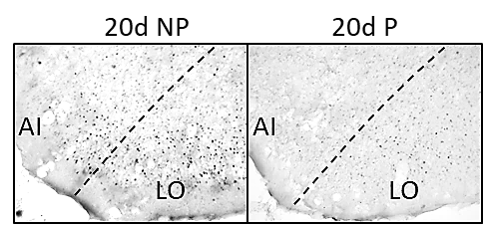
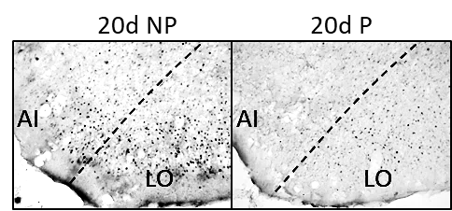
Test 1
1h
c-Fos
a
8d
20d
**
**
P = Persistent rats
% Time on platform
NP = Non-persistent rats
8d NP
8d
P
20d NP
20d P
b
Activated in persistent rats (8d)
c
Activated in non-persistent rats (20d)
PL
8d NP
PL
8d P
20d NP
20d P
PL
20x
NAc-Core
20x
AI/LO
20x
PVT
20x
p=0.1
*
**
**
*
*
*
p=0.08
c-Fos density
c-Fos density
20d NP
20d P
8d NP
8d NP
20d NP
8d
P
8d NP
20d NP
8d
P
20d P
8d
P
20d P
20d NP
20d P
8d NP
8d
P
NAc-Shell
DLS
*
p=0.1
20d NP
20d P
8d NP
8d NP
20d NP
8d
P
8d
P
20d P
Eliminate from the main figures

Slide 5
a
Experimental groups
Cond → Ext-RP
8d → 4d
20d → 4d
b
20d → 10d
Last day of Cond.
(no barrier)
Last day of Ext-RP
(with barrier)
Test
(no barrier)
8d→4d
20d→4d
*
*
P
38%
NP
P
89%
*
*
NP
% Time on platform
% Time freezing
% Time on platform
20d→10d
NP
P
37%
8-4
8-4
8-4
20-4
20-4
20-4
c
20-10
20-10
20-10
AI/LO
PL
AI/LO → PL (?)
r = -0.28 ^{(ns)}
r = -0.45*
r = -0.71**
c-Fos density
c-Fos density
PL c-Fos density
20-10
20-4
% Time on platform
% Time on platform
AI/LO c-Fos density

